Slide 1
Assessment Of Diastolic Function By Echocardiography
Dr S G Shyam Lakshman
S R Cardiology

Slide 2
Overview
Introduction of Diastole and epidemiology of diastolic dysfunction
Determinants of diastolic function.
Functional and morphological correlates, Echo and Doppler parameters of diastolic dysfunction.
Advances in determination of diastolic function by echocardiography.
Grading of diastolic dysfunction.
Approach to a case of diastolic dysfunction.
MCQ’S

Slide 3
Introduction
Diastole- in Greek means to “set apart” or expand.
May be defined as capacity of LV to receive a LV filling volume able in turn its guarantee an adequate stroke volume at low pressure regimen.
LV Diastolic Dysfunction-Inability of LV to attain a normal end diastolic volume without an appropriate increase in LV EDP.
Left ventricular (LV) diastolic function is an integral part of the routine evaluation of patients presenting with symptoms of dyspnoea or heart failure.

Slide 4
Physiology
Ventricle has 2 functions- Systolic ejection and Diastolic filling.
Diastolic phase- LV relaxation and LV filling.
LV relaxation- Start of relaxation and reduced ejection
Iso volumetric relaxation
LV filling- Rapid phase
Slow filling(diastasis)
Atrial systole
LA functions as Reservoir during systole- conduit during early diastole and pump during late diastole.

Slide 6
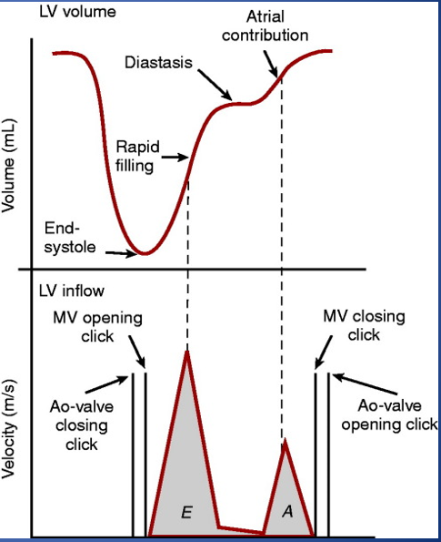

Slide 8
Epidemiology of HFpEF
Accounts for 50 % of cases of heart failure.
Commoner in older females assoc with obesity.
Associated with HTN, DM, DLP,AF.
Usually have worse prognosis than those with reduced EF.
Evidence of diastolic dysfunction by Doppler echocardiography or cardiac catheterization.

Slide 10
Determination of LV Diastolic function
Ventricular relaxation and compliance-Haemodynamic load (afterload)
Synchrony
Cellular mechanisms
LA volume and function
Heart rate
Pericardium.
Derangement of any of the above will lead to abnormal filling pressures and diastolic dysfunction.

Slide 11
Determinants of LV filling
Early Filling
Late filling
Preload
Trans mitral flow rate
Atrial Pressure.
Cardiac rhythm
Atrial contractile function.
Ventricular end diastolic pressure.

Slide 12
Estimation of LV relaxation
IVRT.
Maximum rate of pressure decline dp/dt (iso volumetric pressure decay)
Time constant of relaxation or tau
IVRT
Time interval between Aortic valve closure and mitral valve opening.
Provides insight into the rate of early diastolic LV relaxation.
Affected by heart rate and arterial pressure.
Relaxation is prolonged, mitral valve opening is delayed and hence IVRT is increased.
≤70 in normal subjects.

Slide 13
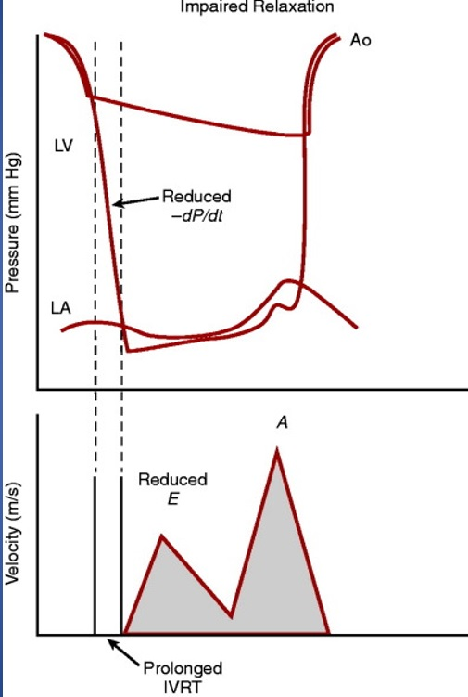

Slide 14
Iso volumetric pressure decay
Simplest way is to measure the rate of pressure fall is dp/dt.
Altered by changes in loading conditions.
After load dependent.
Increase in dp/dt signifies increase in myocardial relaxation or rise of aortic pressure.
HfpeEf have larger dp/dt
During myocardial ischaemia, dp/dt decreases and increases in response to ß Adrenergic stimulation and milrinone

Slide 15
Tau and Time constant of Ventricular relaxation
Described in 1976 by Weiss et al.
Best index to evaluate left ventricular diastolic function, available traditionally in cath lab.
Time constant T (tau)describes the rate of LV pressure decline throughout isovolumic relaxation.
LV pressure(dp/dt) = P₀e-^{t/τ} where P₀ is LV pressure at end ejection and τ is the exponential time constant. (Bw-10th Ed.)
The larger the value of τ, the longer it takes for the LV pressure to fall and the more impaired is relaxation

Slide 17
Estimation of Left Ventricular Stiffness
LV stiffness is defined as the ratio of LV diastolic pressure and LV diastolic volume (LV dP/dV) at any given LV diastolic volume.
LV compliance is the reciprocal of stiffness (LV dV/dP)
Pressure Volume Curves
Describes passive characteristics of LV during diastole.
DPVR is nonlinear and can be approximated by an exponential function.

Slide 18
Stiffness will increase as the left ventricle fills to higher LV diastolic volumes; thus as the left ventricle fills, it becomes stiffer.
DPVR can be approximated by an exponential function, its position and shape can be described by the constants within an equation such as the following: P =  × e^{βV}, where α and β represent the “stiffness constants.”
β does not indicate stiffness but instead describes how rapidly stiffness increased with increases in volume (β = [dP/dV]/V).
Stiffness constants” derived in this fashion can be used to compare passive diastolic properties in different patients or patient groups.

Slide 19
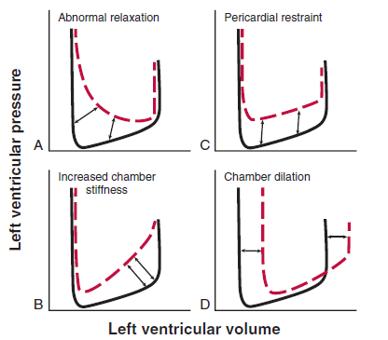

Slide 21
Echo Diagnosis Of Diastolic Function
Aptly described as non invasive “Swan ganz catheterization”
2D
M Mode.
Doppler- PW, CW and TDI
Newer modalities like Speckle tracking echocardiography

Slide 22
Morphologic and functional correlates.
Mitral inflow patterns
Valsalva Maneuver.
Pulmonary venous flow.
Colour M mode flow propagation Velocity.
Tissue Doppler annular early and late diastolic velocities.
Deformation indices.

Slide 23
Morphologic and functional correlates of diastolic dysfunction
LV hypertrophy.
LA Volume.
LA function.
PA systolic and Diastolic pressures.

Slide 24
LV Hypertrophy
Concentric hypertrophy or remodeling can be observed in Diastolic HF.
Eccentric LV hypertrophy in depressed Efs.
MC cause- Hypertension as it causes LVH.
LV mass best measured by 3D echo but in 2D echo at least LV thickness should be measured.
LV wall thickness should be measured to arrive conclusions on LV diastolic function.
Relative wall thickness PW+IVS/LVID
Relative wall thickness ≥0.42 used as threshold for pathologic LVH

Slide 25
LA Volume
Feasible and reliable.
Bi Plane method.
Apical 4-chamber and 2-chamber views .
Signifies cumulative effect of increased filling pressures.
Normal- 16-34 ml/m²
LA volume index >34 mL/m² is an independent predictor of death, heart failure, atrial fibrillation, and ischemic stroke in diastolic dysfunction.
False results- Bradycardia, anemia and other high-output states, atrial flutter or fibrillation, and significant mitral valve disease.

Slide 26
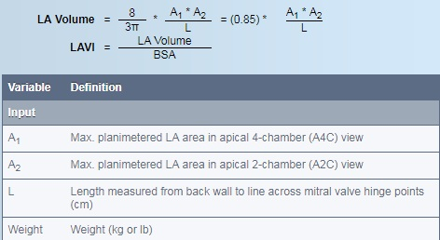
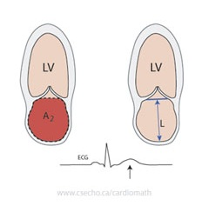

Slide 27
LA function
Functions as reservoir, conduit and pump.
Ventricular systole and isovolumic relaxation, when the atrio ventricular (AV) valves are closed, atrial chambers work as distensible reservoirs.
Pumping chamber, which contributes to maintaining adequate LV end-diastolic volume.
Reservoir volume=LA passive emptying volume -blood flow reversal in the pulmonary veins with atrial contraction.

Slide 28
LA stroke volume = LA volume at the onset of the electrocardiographic P wave-LA minimum volume .
Conduit Volume LV stroke volume- (LA passive + active emptying volumes).
Impaired LV relaxation is associated reduction in LA conduit volume, while the reservoir-pump complex is enhanced to maintain optimal LV end-diastolic volume and normal stroke volume.
More advanced degree of diastolic dysfunction, LA stroke volume decreases due to LA contractility.

Slide 29
PA systolic and Diastolic pressures
Symptomatic Diastolic dysfunction assoc Increased pulmonary artery (PA) pressures.
Peak velocity of the tricuspid regurgitation (TR) jet by continuous-wave (CW) Doppler together with systolic right atrial (RA) pressure are used to derive PA systolic pressure.
PASP = 4 X TR (V)² + RAP
PADP = 4 X PR (V)² + RAP
PA diastolic pressure may be used as a surrogate for measuring mean pulmonary wedge pressure.

Slide 31
Mitral Inflow
Apical 4-chamber view.
CW Doppler to assess peak E (early diastolic) and A (late diastolic) velocities.
Primary measurements-peak early filling (E-wave) and late diastolic filling (A-wave) velocities, the E/A ratio, deceleration time (DT) and IVRT.
Secondary measurements include Mitral A wave duration, diastolic filling time, A-wave velocity-time integral, and the total mitral inflow velocity-time integral.

Slide 32
Mitral E-wave velocity- LA-LV pressure gradient.
Affected by preload and alterations in LV relaxation.
A-wave - LV relaxation, LV diastolic pressures following mitral valve opening, and LV compliance.
Clinical Implications
In DCM, PW Doppler mitral flow velocity variables and filling patterns correlate better with cardiac filling pressures, functional class, and prognosis than LV EF.

Slide 33
Short IVRT, short mitral DT, and increased E/A velocity ratio characterize advanced diastolic dysfunction, increased LA pressure, and worse functional class.
In coronary artery disease or hypertrophic cardiomyopathy in whom LV EFs are 50%, mitral variables correlate poorly with hemodynamics.
Limitations
Sinus tachycardia and first degree AV block.
3:1 or 4:1 AV block.

Slide 34
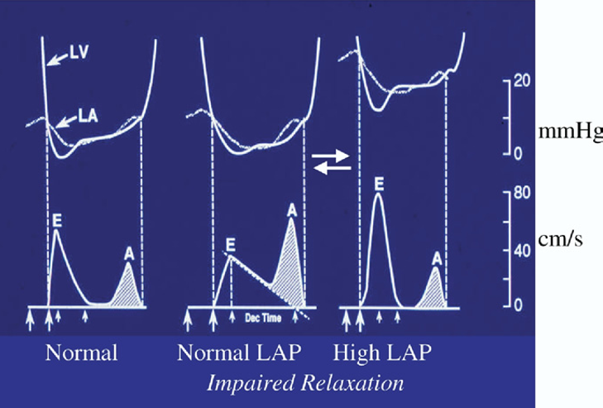

Slide 36
Valsalva Maneuver
Forceful expiration against closed mouth and nose.
Mitral flow patterns altered in phase II.
Decrease of 20 cm/s in mitral peak E velocity considered adequate.
Clinical Implication
Pseudo normal- Impaired relaxation.
Mitral E velocity decreases with a prolongation of DT, whereas the A velocity is unchanged or increases, such that the E/A ratio decreases.
Absolute A velocity (peak A minus the height of E at the onset of A)-decrease of 50% in the E/A ratio is highly specific for increased LV filling pressure

Slide 37
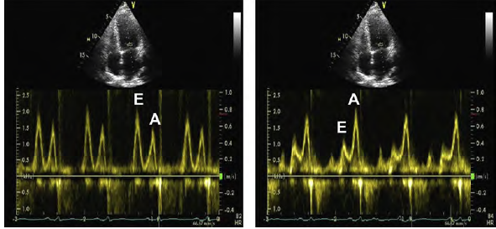
Limitations
Not everyone is able to perform this manoeuvre adequately.
Not standardized.

Slide 38
Pulmonary Venous Flow
Apical 4-chamber view.
Can be obtained in 80% of ambulatory patients.
Peak systolic (S) velocity, Peak anterograde diastolic (D) velocity and atrial reversal velocity(Ar).
S/D ratio, systolic filling fraction , and the peak Ar velocity in late diastole.
Mitral A-wave duration (Ar – A).
A decrease in LA compliance and an increase in LA pressure decrease the S velocity and increase the D velocity, resulting in an S/D ratio <1, a systolic filling fraction <40% and a shortening of the DT velocity <150 ms

Slide 39
Clinical Implications
In pts with depressed EFs, a reduced systolic fraction of anterograde flow (40%) is related to decreased LA compliance and increased mean LA pressure.
Ar -A duration is an age-independent indication of increase LV A-wave pressure.
Can separate patients with abnormal LV relaxation into those with normal filling pressures and those with elevated LVEDPs but normal mean LA pressures. (Ar-A dur>30 msec)
Limitations
Difficulty in obtaining high-quality recordings.
Sinus tachycardia and first-degree AV block, EF>50%, Mitral valve disease ,AF.

Slide 41
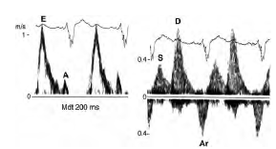

Slide 42
Colour M-Mode Flow Propagation Velocity
MC method is slope method.
Flow propagation velocity (Vp) is measured as the slope of the first aliasing velocity during early filling.
Vp >50 cm/s is considered normal.
Semi quantitative marker of LV diastolic dysfunction.
E/Vp in combination with IVRT can be used to predict LV filling pressures.
E/Vp ≥2.5 predicts PCWP > 15 mm Hg with reasonable accuracy
Prediction of LV filling pressures in patients with normal Ef’s should be with caution as they can have misleadingly normal Vp.

Slide 44
Tissue Doppler Annular Early and Late Diastolic Velocities
Apical views.
Primary measurements include systolic (S), early diastolic, and late diastolic velocities.
Early diastolic annular velocity has been expressed as Ea, Em, E´, or e´, and the late diastolic velocity as Aa, Am, A´, or a´.
Time interval between QRS complex- e´ onset time is prolonged in impaired LV relaxation.
Annular e´/a´ and (E/e´) ratio is calculated.
[QRS-E]- [QRS-e’]=T_{E-e´}
Doppler E/e´ ratio is helpful in estimation of filling pressures and LV relaxation.

Slide 45
Septal e´ velocity < lateral e´ velocity & septal E/ e´ > lateral E/ e´ .
With age, e´ velocity decreases, whereas a´ velocity and the E/e´ ratio increase
Septal E/e´ <8 is usually associated with normal LV filling pressures.
Septal E/e´ >15 is associated with increased filling pressures.
IVRT/T_{E-e´} ratio <2 has reasonable accuracy in identifying patients with increased LV filling pressures
Limitations
Normal individuals.
e´ may be decreased in annular calcification, surgical rings, mitral stenosis, and prosthetic mitral valves.

Slide 46
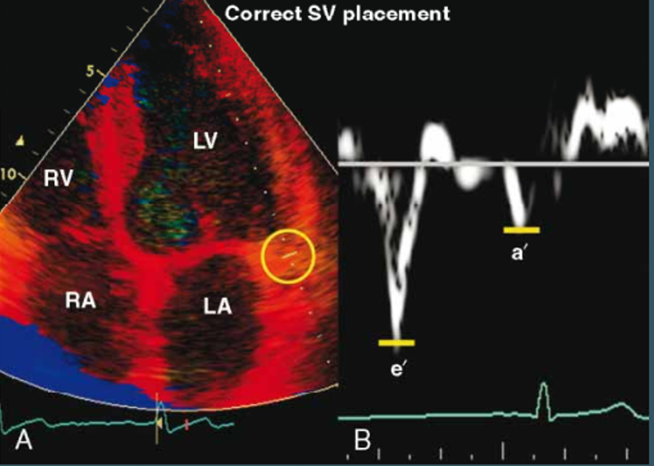

Slide 47
Septal
Lateral

Slide 48
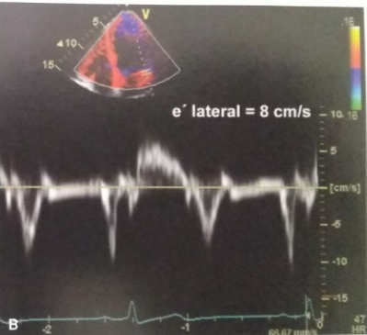

Slide 49
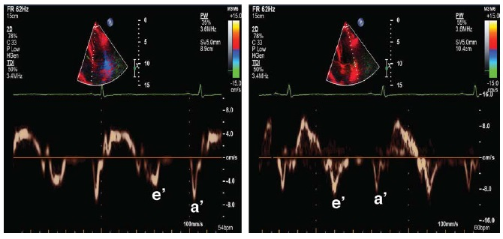

Slide 50
Deformation Indices
Strain is most often expressed as a percentage or fractional strain.
long axis and short axis.
Measured by 2D 3D or 4D speckle-tracking echocardiography.
Angle independent.
Post systolic myocardial strain as a measure of post ejection shortening in ischemic myocardium.
Global myocardial strain rate during the iso volumetric relaxation period (by speckle tracking) and mitral E velocity/global myocardial strain rate ratio predicted LV filling pressure in patients in whom the E/e´ ratio was inconclusive and was more accurate than E/e´.

Slide 51
LV global longitudinal diastolic strain rate measurements during the isovolumic relaxation period and during early diastole by STE have a significant association with the time constant of LV relaxation (t).
LV untwisting rate is another parameter that can be used as a surrogate of LV relaxation.
LA systolic strain can be combined with invasive and non invasive measurements of LAP to estimate LA stiffness.

Slide 52
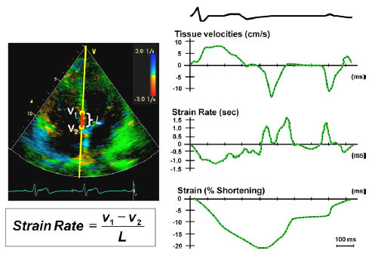

Slide 53
Surrogate Measurements of LV relaxation
Mitral inflow velocities- E/A ratio <1 and DT >240 ms have high specificity for abnormal LV relaxation.
Tissue Doppler annular signals- Tissue Doppler e´ is a more sensitive parameter.
Lateral e´ <8.5 cm/s and septal e´<8 cm/s have impaired myocardial relaxation
Colour M-Mode Vp- Normal Vp is 50 cm/s and correlates with the rate of myocardial relaxation

Slide 54
Surrogate Measurements Of LV stiffness
DT of mitral E velocity.
DT is proportional to the inverse square root of LV stiffness, provided LA pressure is constant.
LA stiffness does not change during the period of deceleration of early LV filling
A-Wave transit time
The time taken for the pressure-velocity wave to propagate through the ventricle, referred to as A-wave transit time.
Measured using PW Doppler echocardiography.
Relates well to late diastolic stiffness (and LVEDP)

Slide 55
DIASTOLIC STRESS TEST
Detect reduced LV systolic and/or diastolic reserve capacity in the setting of diastolic dysfunction.
Increase stroke volume without significantly increasing filling pressures.
Cannot augment myocardial relaxation with exercise compared with normal subjects.
Cardiac output achieved at the expense of increased LV filling pressures.
Indicated when resting echocardiography does not explain the symptoms of heart failure or dyspnoea, especially with exertion.
Most appropriate patient population for diastolic exercise testing is the group of patients with grade 1 diastolic dysfunction, which indicates delayed myocardial relaxation and normal LA mean pressure at rest.

Slide 56
Classification of diastolic dysfunction
Grade 1 : ( Mild) Impaired relaxation with normal filling pressure.
Grade 2 : (Moderate) Pseudo normalized mitral flow pattern.
Grade 3 : (Severe Reversible) Reversible restrictive with high filling pressure.
Grade 4 : (severe Irreversible) Irreversible restrictive with high filling pressure.

Slide 57
Grade I
Earliest abnormality is impaired relaxation.
Mild diastolic dysfunction with slow LV relaxation.
Haemodynamically causes delay in the LV pressure curve during iso volumetric relaxation.
Prolongs IVRT.
Rate of deceleration of early mitral flow decreases thereby DT is prolonged
Mitral flow during atrial systole increased.
Filling pressures are normal.

Slide 58
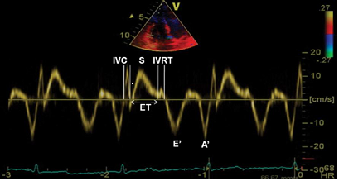

Slide 59
Grade II
Otherwise known as pseudo normalization.
Impaired relaxation+ decrease in chamber compliance.
IVRT shortens.
Early mitral flow restored back to normal.
LA contractility is maintained so mitral flow appears normal.
Pulmonary venous flow shows diastolic predominance

Slide 61
Grade III
Called restrictive filling or restrictive physiology.
Left ventricular compliance becomes increasingly abnormal.
Shortening of IVRT and increase in E.
Rapid Equilibration of LA- LV pressure.
Pulmonary venous flow shows diastolic predominance with prominent flow reversal.
Ar-A is prolonged (>30).
Reversibility.

Slide 63
Grade IV
Irreversibly restrictive.
Preload manipulation no longer leads to improvement in filling pattern.
Maintaining precarious balance between volume overload and hypoperfusion can be difficult.

Slide 65
Approach to grade Diastolic Dysfunction

Slide 66
Grading of diastolic dysfunction

Slide 69
Summary of diastolic indices

Slide 71
LV filling pressure in special population
HCM with severe MR- Ar‑A duration ≥30 ms and peak TR jet velocity 2.8 m/s.
AF- short DT (130 ms) , E/e’ and IVRT <65ms.
Av block and pacing- Peak velocity of TR >2.8 m/s, E/e’ not reliable.
Aortic stenosis and regurgitation -Average E/e’ ratio >14 ,Peak velocity of TR >2.8 m/s.
MS, MR and MAC- IVRT: 1.5 m/s , IVRT/TE‑e’ ratio,E/e’ not reliable.
Post heart transplantation-peak velocity of TR is only helpful parameter in evaluating mean LAP provided pulmonary causes are excluded to detect graft rejection.

Slide 75
Conclusion
Hfpef is a common disease in 50 % of cases of heart failure.
Diastole is a complex, energy-dependent process.
Echo indices of diastolic function include transmitral Doppler inflow, TD velocities, pulmonary venous Doppler study, and Color M-mode propagation velocity.
Diastolic dysfunction is a measurable, step-wise progression from normal to irreversible.
Ongoing research

Slide 76
Bibliography
Braunwald’s Heart disease- 10th Edition.
ASE/EACVI Guidelines and standards- Recommendations for the Evaluation of Left Ventricular Diastolic Function by Echocardiography:-An Update from the American Society of Echocardiography and the European Association of Cardiovascular Imaging.
EAE/ASE recommendations- Recommendations for the Evaluation of Left Ventricular Diastolic Function by Echocardiography.
Echocardiographic Assessment of Diastolic Function Aniruddha De1 1 Department of Non-invasive Cardiology, Apollo Gleneagles Hospital, Kolkata, West Bengal, India
Feigenbaum’s Echocardiography- 7th Edition.
Grossmann and Baim’s cardiac catheterization, angiography and intervention.

Slide 77
MCQ’S

Slide 78
All the following are determinants of early LV filling except
Preload.
Cardiac rhythm.
Trans mitral flow rate.
Atrial Pressure.
Ans: Cardiac rhythm

Slide 79
LAVI more than what value is an independent predictor of mortality in death in diastolic dysfn
24 mL/m²
34 mL/m²
44 mL/m²
54 mL/m²
Ans: 34 mL/m²

Slide 80
Below picture depicts which grade of diastolic dysfunction
Grade I
Grade II
Grade III
Grade IV
Ans : Grade II

Slide 81
Which of the following signifies grade IV Diastolic dysfunction all except
DT- 120 msec.
E/é -14
D>S and Ar-A=24
Vp< 45
Ans: D>S and Ar-A=24

Slide 82
Name the condition and the phenomenon is known as- No options

Slide 83
All the following are true except
Diastolic stress test is done to detect reduced LV systolic and/or diastolic reserve capacity in the setting of diastolic dysfunction.
Normal Diastolic stress test response is increase stroke volume with increased filling pressures.
LV global longitudinal diastolic strain rate measurements during the isovolumic relaxation period in speckle tracking echocardiography.
LV untwisting rate is another parameter that can be used as a surrogate of LV relaxation.
Ans: Normal Diastolic stress test response is increase stroke volume with increased filling pressures.

Slide 84
E/e’ is not a useful parameter in all the following conditions to estimate filling pressures except
Mitral Regurgitation.
LBBB
Atrial fibrillation.
Post transplant.
Ans: LBBB

Slide 85
Thank You

